Slide 1

Vanessa CHARLES
Customer churn analysis

Slide 2
Problem
Describe the business problem and define the analytic approach to solving the problem.
The problem of the telecom company is because of several rivals that are constantly trying to steal customers hence they lose their customers they automatically they lose money .
The stakeholders impacted by the problem are the company executives,the marketing team and the customer service team and the investors.
This is a huge problem for the company because losing customers is costly for any business, as it can directly affect the profitability of the company.

Slide 3
Methodology
Introduce the methods and data sources used for the analysis. Discuss your choice of variables, methods, and how they will help you address the problem.
For running statistical models or statistical analysis:
Document techniques
Document uncertainty
Document assumptions made

Slide 4
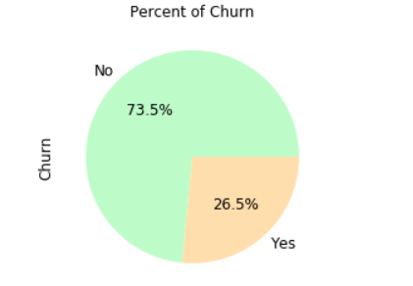
Impact of the Churn
There are about 26.54% of the customers churned
and 74.46% of the customers stayed.

Slide 5
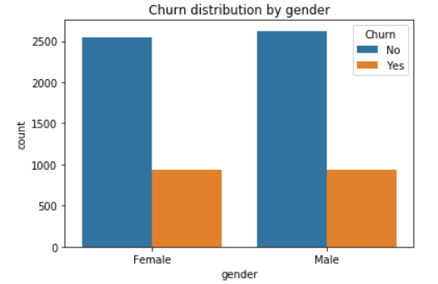
Customer demographics : Gender
From the plot, it looks like gender does not play a role in customer churn Almost as many
women as men have churned during the past
month.

Slide 6
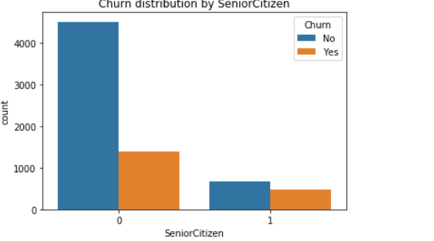
Customer demographics: Age

Slide 7
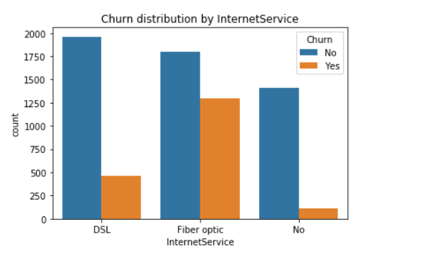
Services used : INTERNET

Slide 9
Bonus
After running these codes, we can see that the company's gonna take about 29 days to lose all his clients.

Slide 10
Discussion & Recommendations
My proposed solution: In light of competition in the market, which is one of the main causes of the churn, after identifying other reasons why customers have left, the telecom company could innovate its services to make changes that will be much more responsive to customer requirements within the carrier to be able to satisfy them much more.

Slide 11
Discussion & Recommendations
What are strengths of the organization that you have leveraged in your solution?
The company has a certain renown in the market as it has been in existence for several years.
The company has a massive market share.
What are weaknesses of the organization that could undermine your solution?
it's hard for the company to get new customers.
What are challenges that you might encounter? How can you mitigate them?

Slide 12
References & Appendices
Provide citations for your work and provide resources for your audience to learn more about the technical aspects of your project. Share links to your GitHub repository or accompanying spreadsheets.

